Slide 1

A Non-Invasive Approach for Diagnosing Endometriosis Using Deep Learning
Supervisor: Miri Weiss Cohen
Daniel Berkowitz
Tal Turjeman

Slide 2
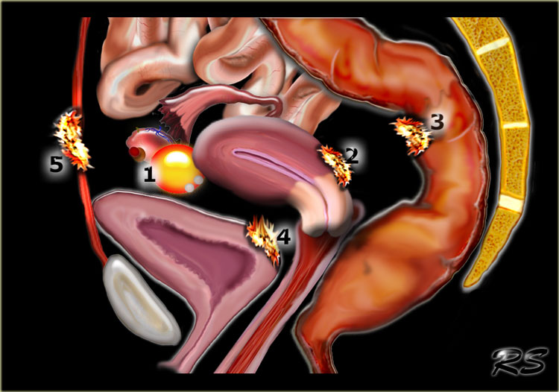

Endometriosis
What is Endometriosis ?
It is an inflammatory, chronic gynecologic disorder that affects about 10% of women worldwide.
Endometriosis is characterized by the growth of endometrial-like tissues outside the uterine cavity.
These growths, called endometriotic lesions, can develop on different pelvic organs.
Unlike normal endometrial tissue, these lesions do not shed during menstruation, leading to inflammation, pain, and scarring.

Slide 3

Common Symptoms of Endometriosis
Severe pelvic pain, especially during menstruation.
Pain during intercourse.
Chronic lower abdominal pain.
Infertility due to tissue scarring.
Bowel and urinary symptoms.
Fatigue and mental health challenges.

Slide 4
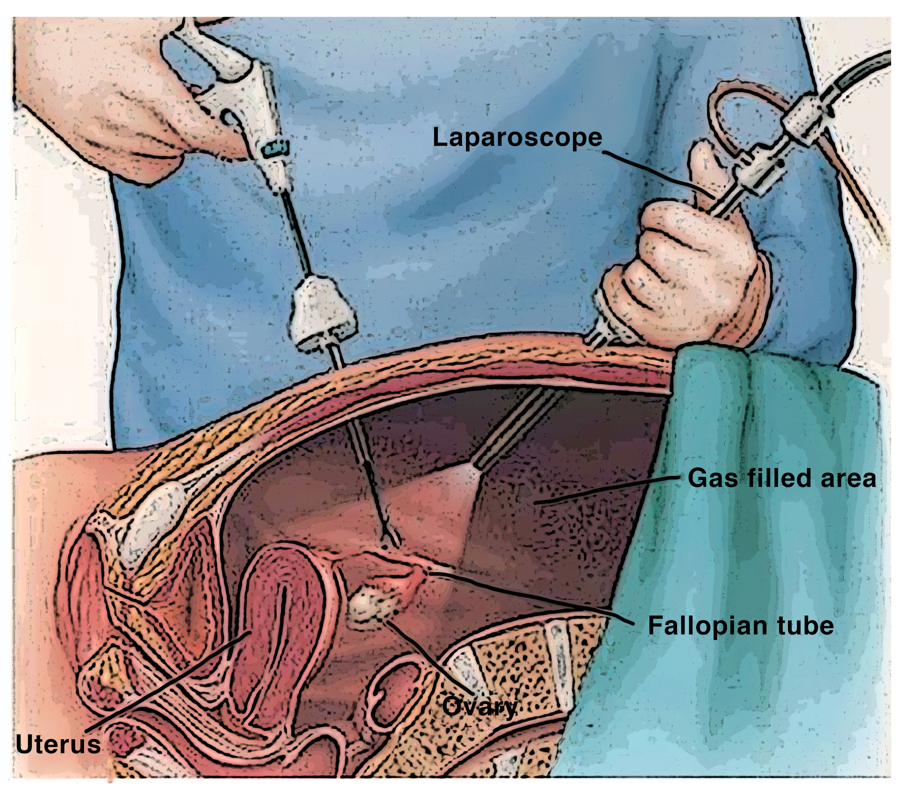
The current situation and need for the project
Endometriosis is often misdiagnosed disease
Many women suffer for years without diagnosis, which significantly affects their quality of life.
The problem with current diagnostic methods
The gold standard for diagnosis is laparoscopy, an invasive and expensive procedure.
Laparoscopy involves inserting a camera into the abdomen to visually confirm the presence of endometrial-like tissue.
The average diagnostic delay is between 8 to 12 years.

Slide 5
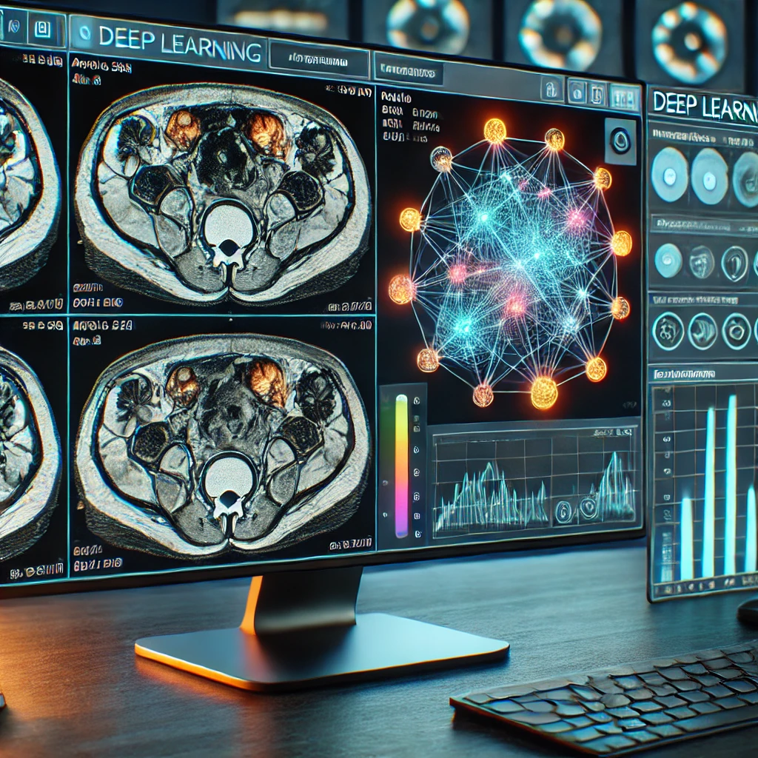
The current situation and need for the project
Why machine learning can help
MRI scans can show endometriotic lesions, but their identification by radiologists is challenging due to variations in size, shape, and location.
Deep learning improves medical imaging by detecting patterns missed by the human eye, allowing faster and more accurate diagnoses.
Currently, there is no machine learning model that is specifically designed to detect endometriosis in MRI scans

Slide 6
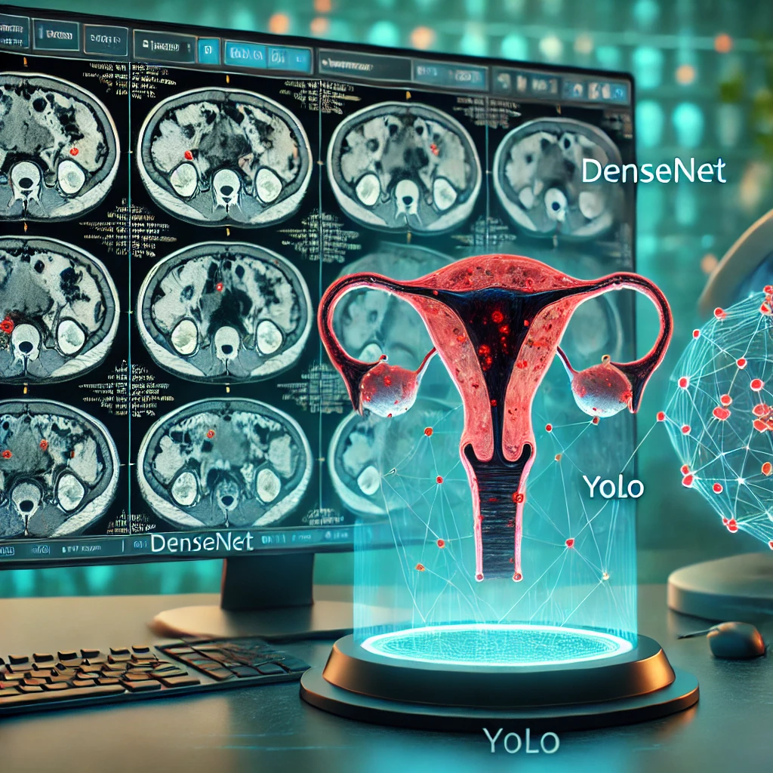
The solution
Deep learning model that analyzes MRI scans to automatically detect endometriosis using DenseNet and YOLO to classify and mark lesions.

Slide 7
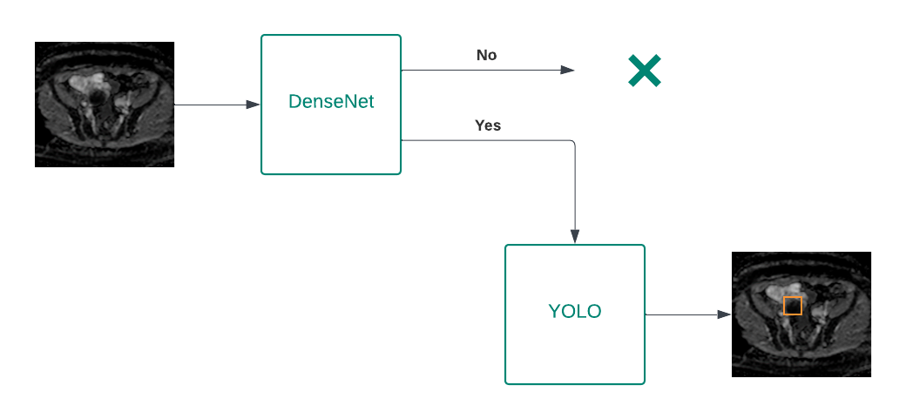
System architecture
The system receives an MRI scan as input.
DenseNet classification:
If the scan does not have evidence of endometriosis, it is discarded.
If the scan has evidence of endometriosis, it is passed to YOLO.
YOLO detection:
YOLO analyzes the classified scan to detect and mark endometriotic lesions.
The output is the final segmented scan with boundary box for each lesion.

Slide 8
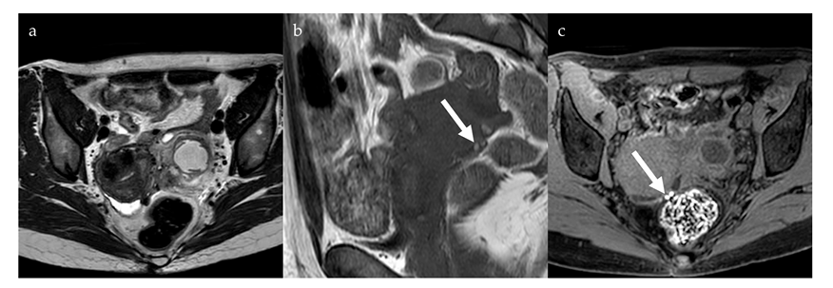
Scientific and technological background
MRI and Endometriosis Diagnosis
MRI is a non-invasive imaging technique that generates detailed images of internal structures.
It is widely used in medical diagnostics, especially for soft tissue evaluation.
Endometriotic lesions can be visualized in MRI scans, making it a valuable tool for diagnosis.

Slide 9
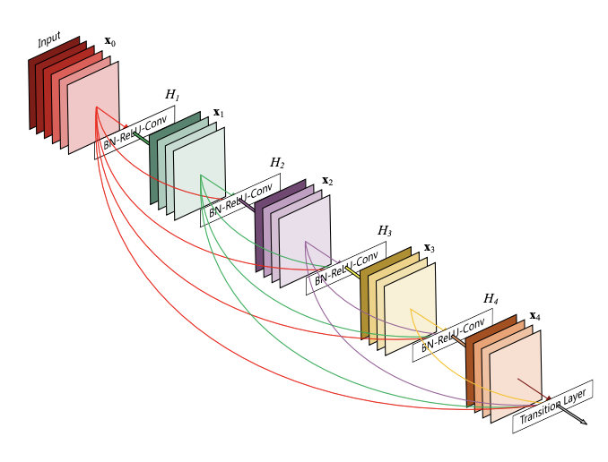
DenseNet
What is DenseNet ?
DenseNet is a deep learning model, and unlike traditional models, where each layer connects only to the next one, in DenseNet, each layer connects to all the subsequent layers.
This means that information flows better, making the learning more efficient.
It is widely used in image classification tasks, particularly in medical imaging, where extracting patterns from complex scans is essential.
How DenseNet is built ?
DenseNet consists of multiple dense blocks with transition layers between them.

Slide 10
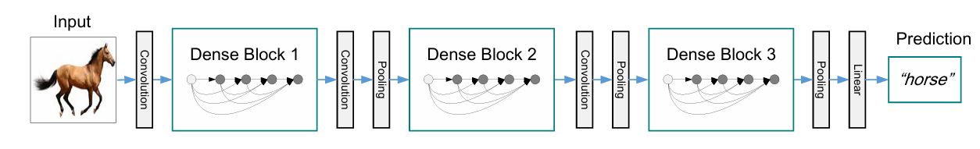
DenseNet
Initial processing
The model gets an image as input.
The image passes through an initial convolutional layer, which extracts basic features.
Dense blocks
A dense block consists of multiple layers where each layer receives the concatenated output of all previous layers as input.
Each layer follows the sequence – batch normalization, ReLU activation and Convolution.

Slide 11
DenseNet
Transition layers
Located between dense blocks, these layers reduce the number of feature maps using a 1×1 convolution and downsample spatial dimensions with 2×2 average pooling.
This controls computational cost and limits excessive feature map growth, which ensures the model is efficient.
Final classification
After passing through all dense blocks and transition layers, the output from the last dense block is passed through a linear layer.
This layer transforms the extracted features into a final prediction by mapping them to specific categories.

Slide 12
Advantages of DenseNet
Fewer parameters –
DenseNet reduces the number of parameters by reusing features from earlier layers, minimizing the need for redundant filters.
Efficient feature reuse –
each layer can access the information learned by the earlier layers, so this layer doesn’t need to relearn the features.
Better gradient flow –
The direct connection between layers helps gradients flow more easily during backpropagation, reducing the risk of vanishing gradients.

Slide 13
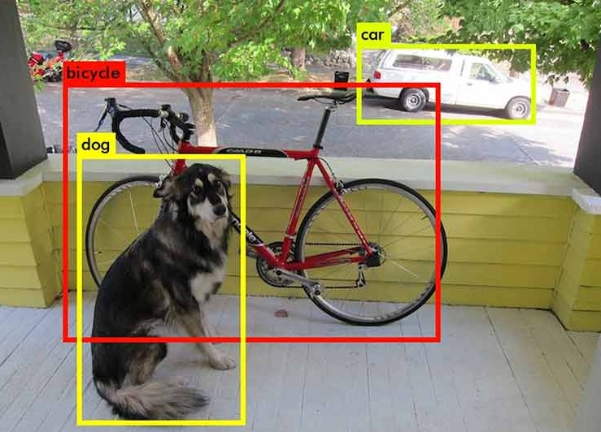
YOLOv8
What is YOLO ?
YOLO is an advanced object detection algorithm that processes an entire image in a single pass, making it one of the fastest and most efficient models for real-time detection.
Unlike traditional object detection methods, YOLO divides the image into a grid and predicts bounding boxes and class probabilities all at once, ensuring both speed and accuracy.

Slide 14
YOLOv8
YOLOv8 improves speed and accuracy compared to older versions. One big change is Anchor-Free Detection, where the model finds an object’s center, width, and height directly instead of using predefined anchor boxes and manually adjusting them during Prediction.

Slide 15
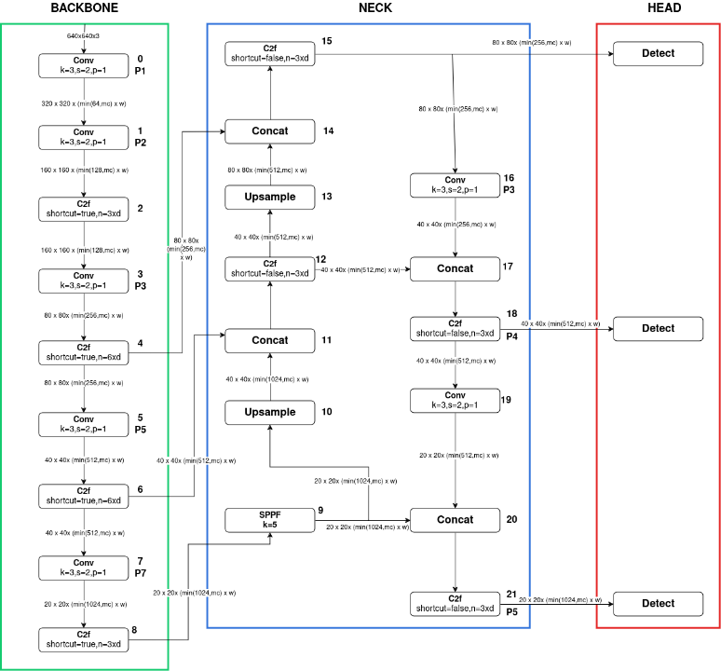
YOLOv8
The model has three main parts –
Backbone
Extracts important features from the image and reducing the feature map size,
using Conv and C2f blocks.
Neck
Combines and improves feature maps from different layers, using Upsample to increase the size of feature maps so they can be combined and Concatenate to merge feature maps with different numbers of channels.

Slide 16
YOLOv8
Head
Uses Detect blocks to find objects, classify them and mark them with bounding boxes based on the receive feature maps.
Thanks to the YOLOv8 design, each Detect block receives from the Neck a feature map of a different size and number of channels which helps detect small and large objects.
We decided to use YOLOv8 because it is one of the best models for object detection .

Slide 17
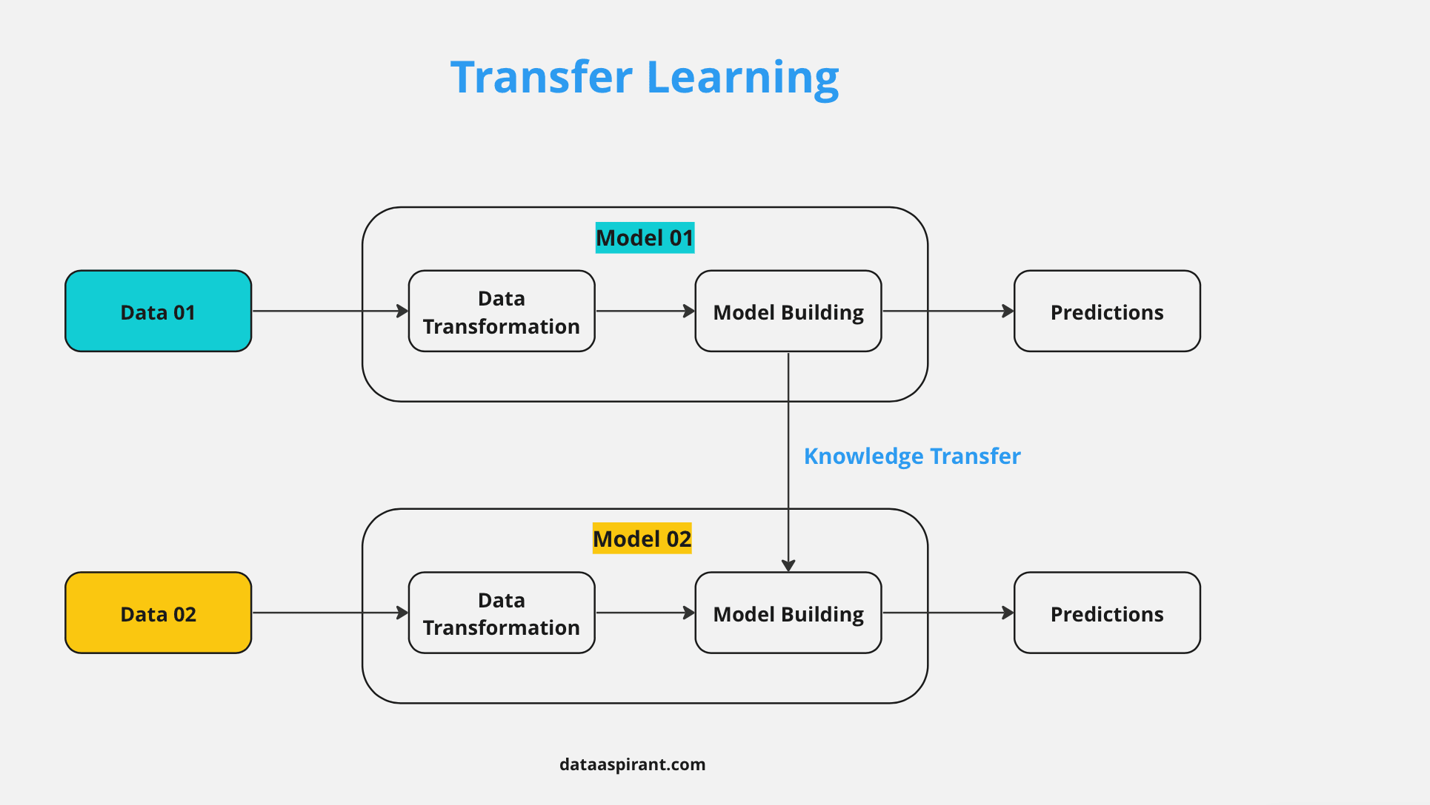
Algorithms and implementation
What is transfer learning ?
This is a machine learning technique that uses pre-trained models to improve performance on new tasks.
Instead of training a model from zero, it allows models to apply knowledge to new datasets.
It is especially useful in fields with limited labeled data, such as medical imaging.

Slide 18

System optimization
Hyper parameters optimization Hyper parameters are:
Predefined parameters.
Applied to improve the system’s performance.
Learning rate – {5⋅e^(-3), 5⋅e^(-4), 5⋅e^(-5) }
Batch size – {16, 32, 64}
Epochs – {50, 100, 150}
Dropout – {0.2, 0.5}
Batch normalization – {with / without}

Slide 19

The results we aim for
Identification of Lesions with high accuracy
The model must accurately detect and differentiate endometriotic lesions with over 80% of accuracy.
A non-invasive diagnostic tool
The system aims to assist or replace laparoscopy for diagnosing endometriosis, making diagnosis faster and more accessible.

Slide 20
Expected challenges
Lesion variability
Endometriotic lesions differ in size, shape, and location, making detection complex.
Differentiating endometriotic lesions from other abnormalities
The model needs to distinguish between endometriosis and other gynecological conditions, to minimize false detections and improve diagnostic reliability.
Limited labeled MRI dataset
The lack of marked medical datasets challenges model training, requiring data augmentation and collaborations with medical institutions.

Slide 21
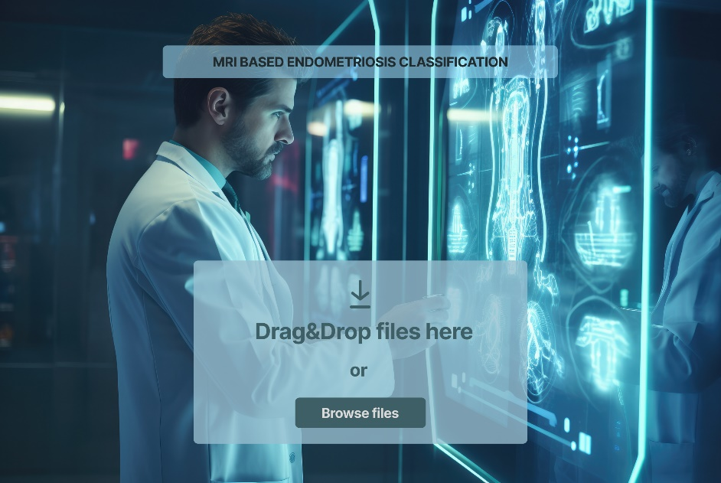
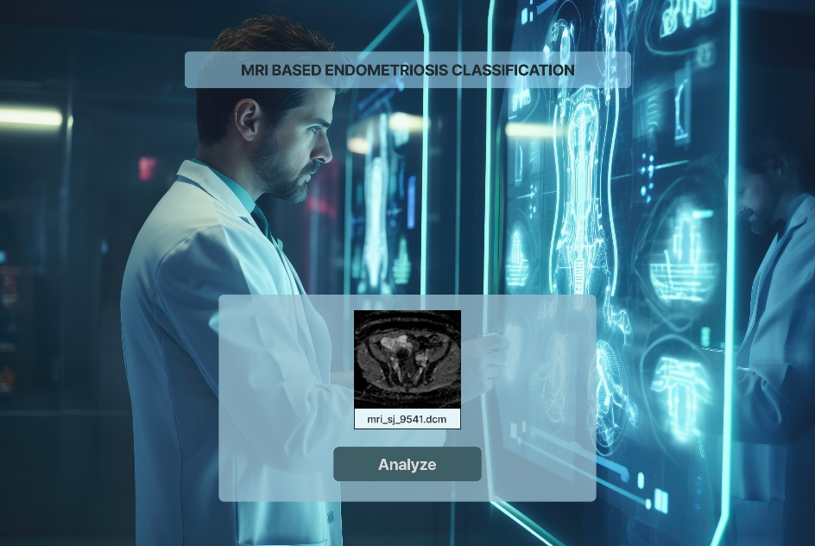
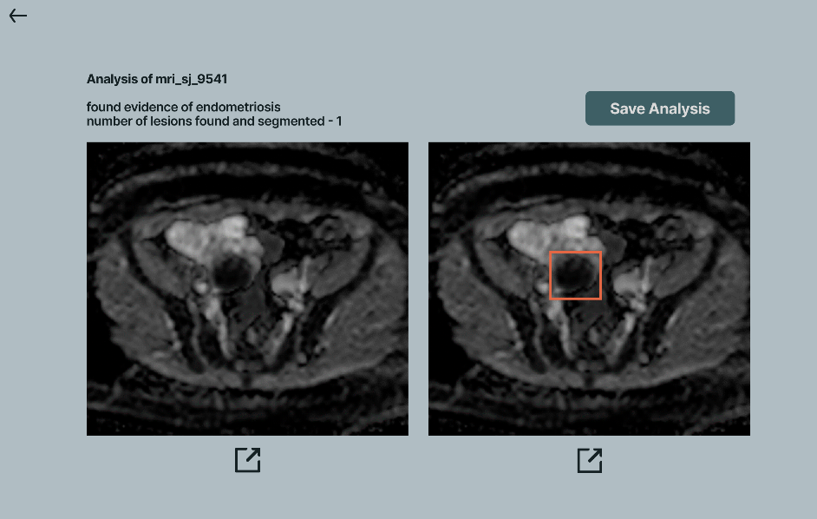
System interface

Slide 22
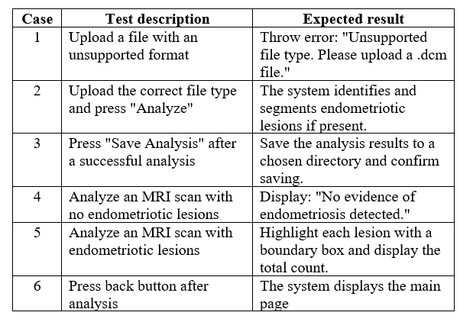
Tests for the system

